Slide 1
NIHB 2015 Annual Consumer Conference
Native Health 2015: Policy, Advocacy and the Business of Medicine
Wednesday, September 23, 2015
Kim Russell, Executive Director

Slide 2
Objectives
Provide a brief overview of the ACOIHC
Provide a brief overview of the Arizona Medicaid System
Describe the process and parts of the current Arizona Section 1115 Waiver Proposal
Describe Reactive and Proactive Responses to the Arizona Section 1115 Waiver
Next Steps

Slide 3
ACOIHC Statutes

Slide 4
ACOIHC Duties
ARS 36-2902.02
Develop a comprehensive health care delivery and financing system for American Indians, specific to each Arizona Indian tribe, with a focus on creating Indian health care demonstration projects pursuant to title XIX of the social security act. In performing this duty the advisory council shall:

Slide 5
ARS 36-2902.02
(a) Develop a comprehensive health care delivery and financing system, specific to each Arizona Indian tribe, that uses title XIX funds and builds on currently available private, state and federal funds.
(b) Develop new title XIX demonstration projects, specific to each Arizona Indian tribe, both on and off reservations in cooperation with this state and the federal government.

Slide 6
ARS 36-2902.02
(c) Facilitate communications, planning and discussion among tribes, this state and federal agencies regarding operations, financing, policy and legislation relating to Indian health care.
(d) Recommend and advocate tribal, state and federal policy and legislation that supports the design and implementation of health care delivery and financing systems specific to each Arizona Indian tribe.

Slide 7
ARS 36-2902.02
(e) Notwithstanding section 36-2903.01, subsection B, in conjunction with the administration, request a federal waiver from the United States department of health and human services that allows tribal governments that perform eligibility determinations for temporary assistance for needy families programs to perform the medicaid eligibility determinations…..
(f) Perform other duties as requested by the legislature.

Slide 8
Medicaid in Arizona:
AHCCCS

Slide 9
Arizona Health Care Cost Containment System
1982- Arizona was last state to join Medicaid
Established Mandatory Managed Care through Section 1115 Waiver
American Indians have choice
  Managed Care Plan
  Fee For Service: American Indian Health Program

Slide 10
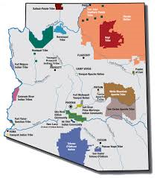
Arizona Health Care Cost Containment System (con’t)
1.75 million members total (as of 8-21-15)
114,296 American Indian Members in the AIHP (as of September 1, 2015)
Approximately 75% of total American Members are Iss are enrolled in the AIHP

Slide 11
Arizona’s Section 1115 Waiver

Slide 12
Timeline
January to March 2015: Arizona Legislature in Session
August 2015: 5 Public Forums and one Tribal Consultation were conducted to solicit input from community stake holders.
Friday, September 25, 2015: Public comments are due.
September 30, 2016: Arizona’s current waiver is scheduled to expire.
October 1, 2016 to September 30, 2021: New 5-year waiver.

Slide 13
Arizona’s Application
The application for a new 5-year waiver includes:
Part I: Governor Ducey’s vision to modernize Medicaid: the AHCCCS CARE program
Part II: The Legislative Partnership
Part III: DSRIP: Arizona’s Approach
Part IV: HCBS Final Rule

Slide 14
Arizona’s Application
Part V: American Indian Medical Home
Part VI: Building Upon Past Successes
  Continue existing authorities such as the uncompensated care payments for Indian Health Services and Tribal 638 Facilities
Part VII: Safety Net Care Pool
Traditional Practitioner Services

Slide 15
Reactive Responses to the Section 1115 Waiver

Slide 16
Part I: CARE Program
Institutes a work requirement on able bodied adults (New Adult Group and TANF Parents)
  Imposes Co-pays and Premiums to deter the non emergent use of emergency departments and ambulance services
Premium contributions go into a Health Savings Account to be used for non covered services ie. Dental, vision, chiropractic services

Slide 17
Part II: Legislative Directives
SB 1092
  Directs the Medicaid Director to submit the wavier every year
  Institutes cost sharing requirements
  Defines able bodied
  Imposes a lifetime 5-year cap

Slide 18
Part II: Legislative Directives (con’t)
SB 1475
  Premium: 2% of the person’s household income
  Co-payment of $8 non emergency use of emergency room then $25 thereafter
  Exemption from Non Emergency Medical Transportation from October 1, 2015 to September 30, 2016

Slide 19
Proactive Responses to the Section 1115 Waiver

Slide 20
Part V: American Indian Medical Home
Developed by the 3 IHS Area Offices in Arizona (Navajo, Phoenix, and Tucson)
Proposes to reimburse for primary care case management, a 24-hour call line and care coordination
Targets American Indians in the Fee for Service AIHP and non-IHS facilities that have high AI/AN inpatient enrollment

Slide 21
Part V: American Indian Medical Home (con’t)
Provides care coordination and continuity of care to the member especially following hospital discharge
Diabetes Education is mandatory
Idea began in 2010

Slide 22
Part VI: Building Upon Past Successes
Continues the existing authority to pay the uncompensated care payments for Indian Health Services and Tribal 638 Facilities
These benefits were eliminated by the state in 2009 and 2010
  Emergency Dental
  Services provided by a Podiatrist
Set to expire on September 30, 2016

Slide 23
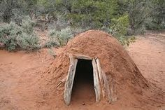
Traditional Practitioner Services
Placeholder in the application
Tribes and tribal partners will develop proposal

Slide 24
Moving Forward

Slide 25
Next steps
Further inform Tribes about the purpose of the Section 1115 Waiver
Identify other demonstration ideas
  TANF Tribes perform Medicaid eligibility
  Behavioral Health
  Oral Health
  Urban Indians
  Community Health Representatives

Slide 26
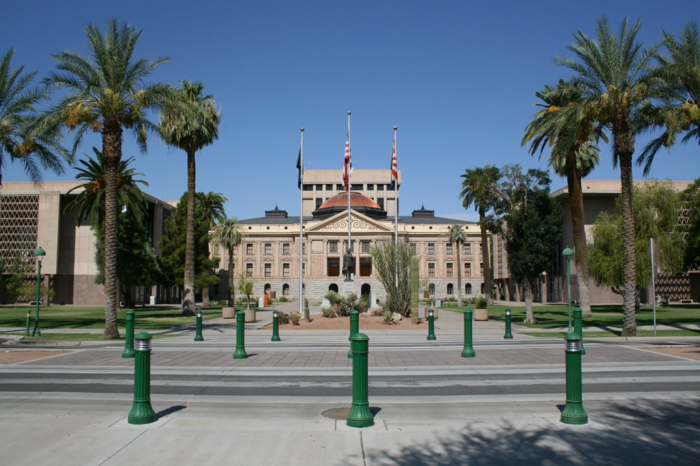
Next steps
Network with other Tribes in other states
Increase collaboration with AHCCCS, Legislature and Governor
Track state legislation

Slide 27
Questions?

Slide 28
Contact:
Kim Russell, Executive Director
Kim.Russell@azahccs.gov
602-374-2575

